Slide 1

Online Book Review System
-Group7

Slide 2

Group-7:
Vallepu Sree Lakshmi Kavya
Varshitha D C
Geddada NavyaTeja
Yendru Pavan Kumar
Anchal Kumari
Dhanush M
Gokul Krishnan M

Slide 3
Contents
Abstract
Introduction
Objective
Tools & Languages Used
App Flow
System Requirements
Features Available
Future Scope
Conclusion

Slide 4
Abstract
Nobody likes to spend money on a new book only to face that overwhelming feeling of disappointment when it doesn't live up to your expectations
A book review is a descriptive and critical/evaluative account of a book. It provides a summary of the content, assesses the value of the book, and recommends it (or not) to other potential readers.
Book Review system allows the admin to add ,delete and edit the book, and also keep track of the user review and ratings. Provides the user register and login to check on the review and rating of the books and also give their review and rating for the books.

Slide 5

Introduction

Slide 6
Introduction
This “ENZ BOOK CLUB” objective is to design Book Review system, and to develop a customer web-based Review system.
The user can give the ratings and Review to the books from their experiences.
Presence of book reviews can help validate the worthiness of a book and establish who the book’s audience is. Then once validated, other similar users are much more likely to want to join their peers and read that same book.

Slide 7
Objective
This system objective is to design Book Review system, and to develop a customer web-based Review system. Where the reader can give the ratings and the reviews.
To let the admin know the books the readers are interested in and publish the required.
Save readers time, prepare them for what they will find and offer them a greater chance of connecting with a particular book, even before they read the first page.

Slide 8
Tools And Languages
Frontend
Angular
Html
Backend
MySQL
CSS
TypeScript
BootStrap
Spring Boot
Spring Boot JPA
Postman(Testing)
Junit Test

Slide 9
System Requirements
The Basic System Requirements for Running this project are listed below:
Visual studio, Eclipse, Postman and MySQL are to be installed to the system
3 GB Random Access Memory
More than 200 MB of Free Space on Hard Disk
Microsoft Windows 8,10,11 or Linux or Equivalent OS
Web Browser (Microsoft Edge, Google Chrome, Firefox)

Slide 10
Modules of Online Book Review System
Admin Module
User Module

Slide 11
Features Available
Admin
Login
View Book Rating
User
Login
Dashboard
Book List (Add,Update,Delete,Enable)
Dashboard
Register
Book List
Add Review
Update User Details
Logout
Logout
Forget Password

Slide 12
E-R Diagram For Admin
Name
password
View Book list
View Rating List
Login
Admin dashboard
logout
Id
Bookname
Username
Review
Rating
View review list
Book list
Add new book
Edit
Delete
View Book List
Id
Name
Author
Price
Category
Add New Book

Slide 13
E-R Diagram For User
Login
Register
User
id
Name password
Email
Phone
Address
Register
Logout
Id
Book name
Username
Rating
Review
Review, Rating
Booklist
User Profile
Name
Password
Forget password
User Dashboard
login

Slide 14

ENZ Book Club

Slide 15
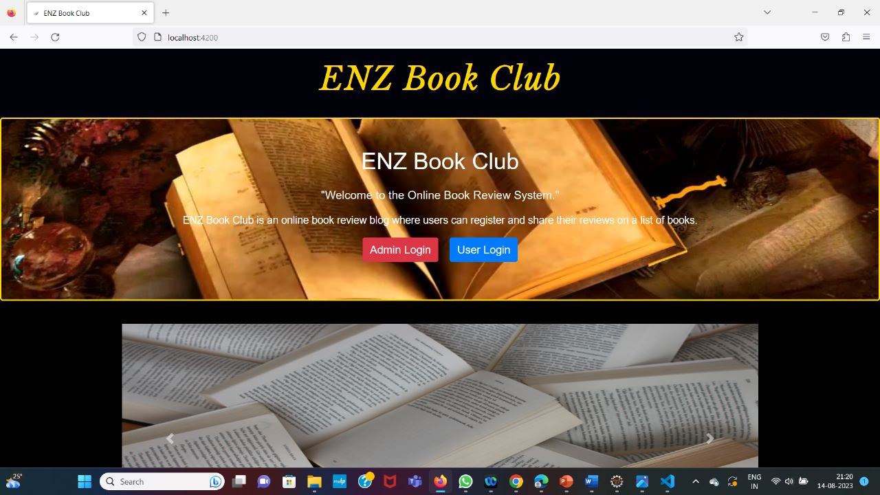
Home Page

Slide 16

Admin Module

Slide 17

Admin Module
In the Admin Module the Admin could Login
The Admin can see the Book Lists and Book Reviews
In the Book’s List, the Admin can perform CRUD operations like ADD, UPDATE and DELETE

Slide 18
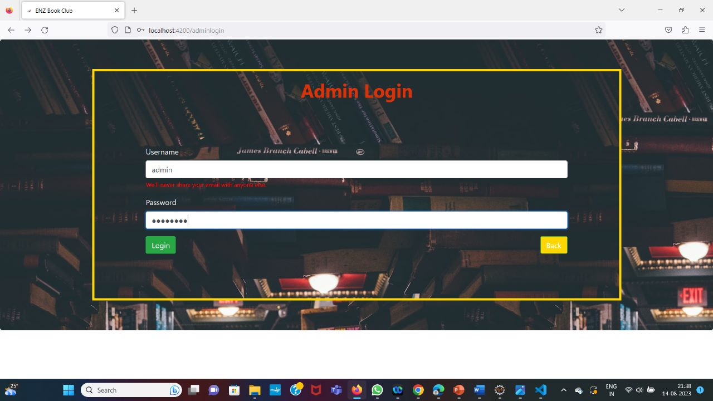
Admin Login

Slide 19
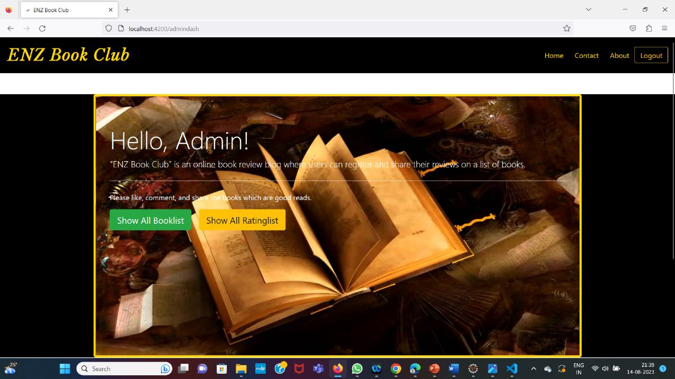
Admin Dashboard

Slide 20
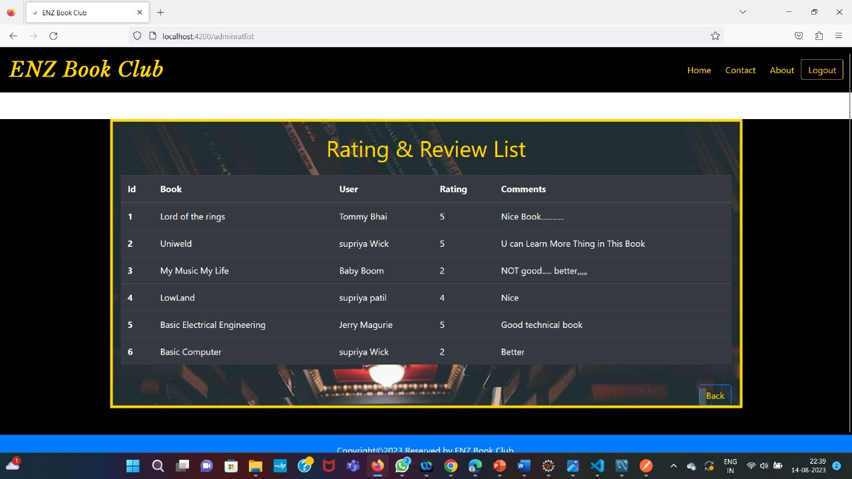
Rating & Review List

Slide 21
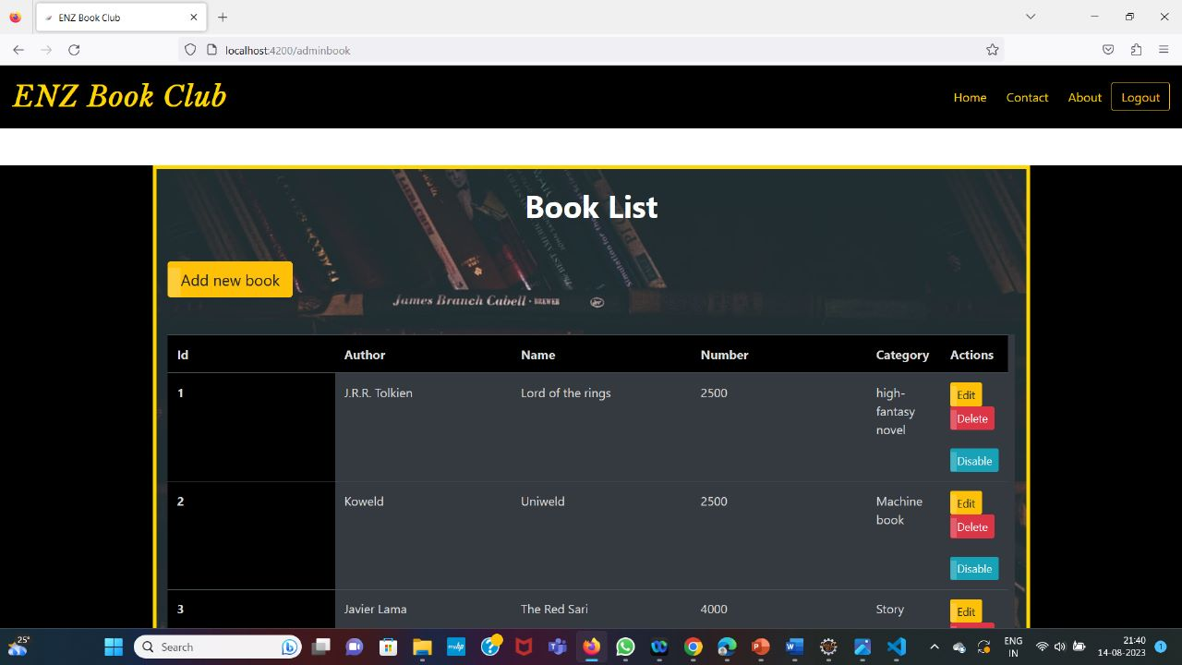
Admin Booklist

Slide 22
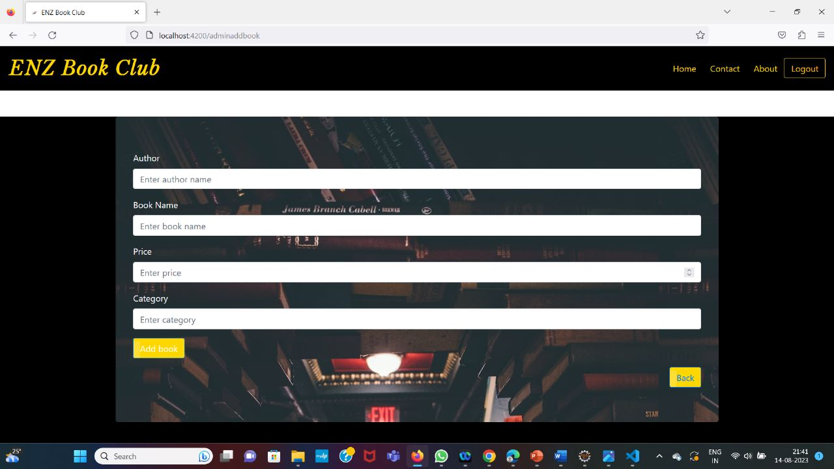
Add Book

Slide 23
Add Book

Slide 24
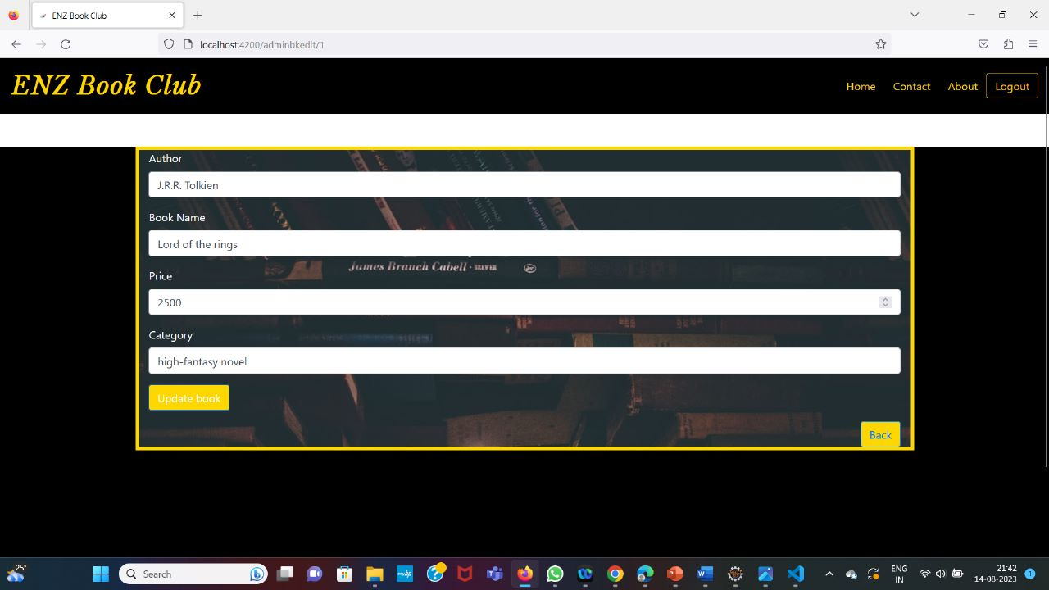
Update Book

Slide 25
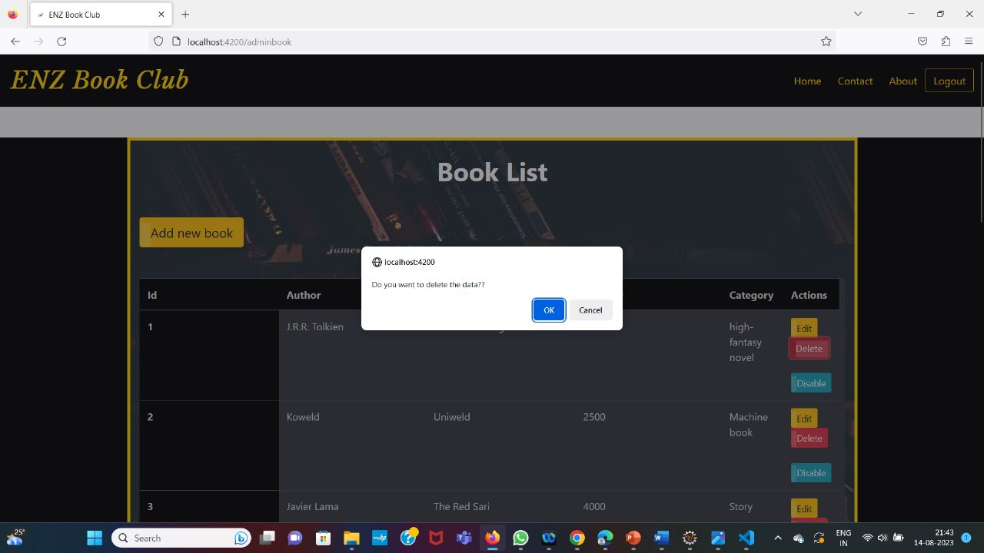
Delete Book

Slide 26

Enable or Disable the Book

Slide 27

User Module

Slide 28


User Module
User can Register and Login
User can see the Book List
User Can Search for the Book and can Rate the Book
User can Update their Profile Details

Slide 29
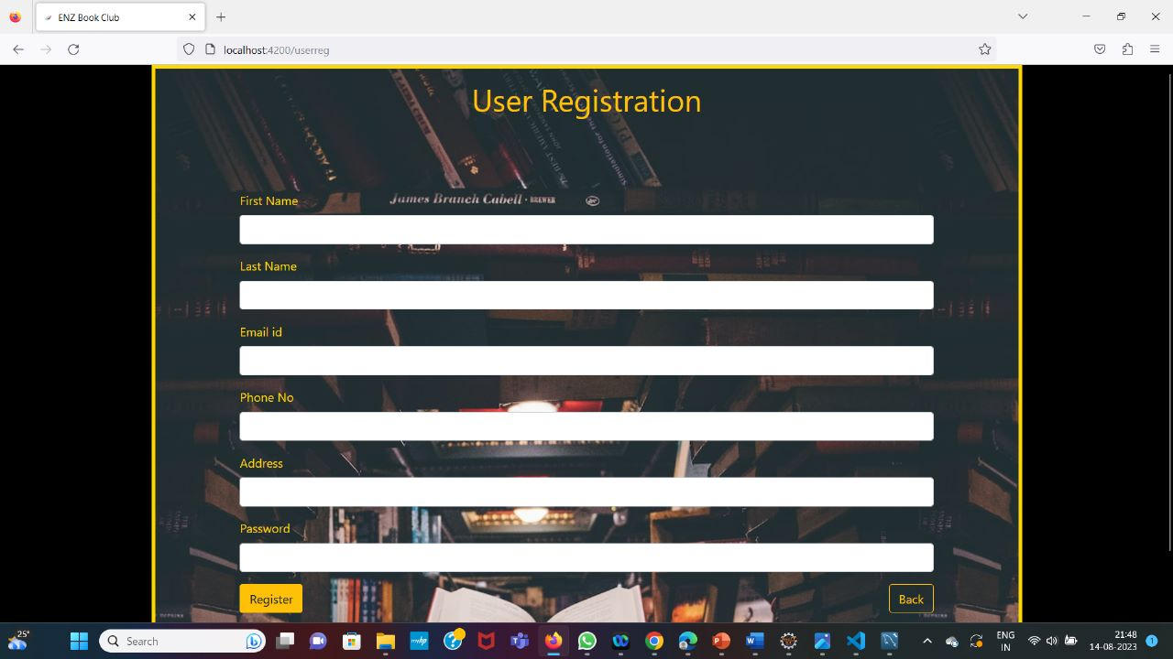
User Registration

Slide 30
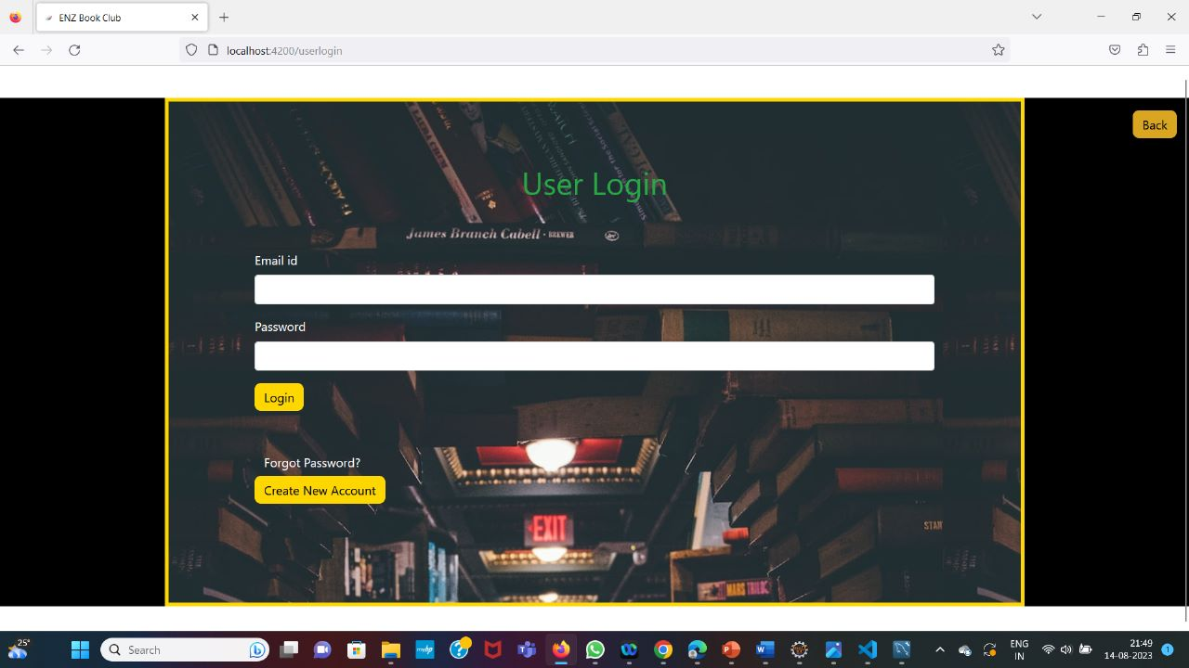
User Login

Slide 31
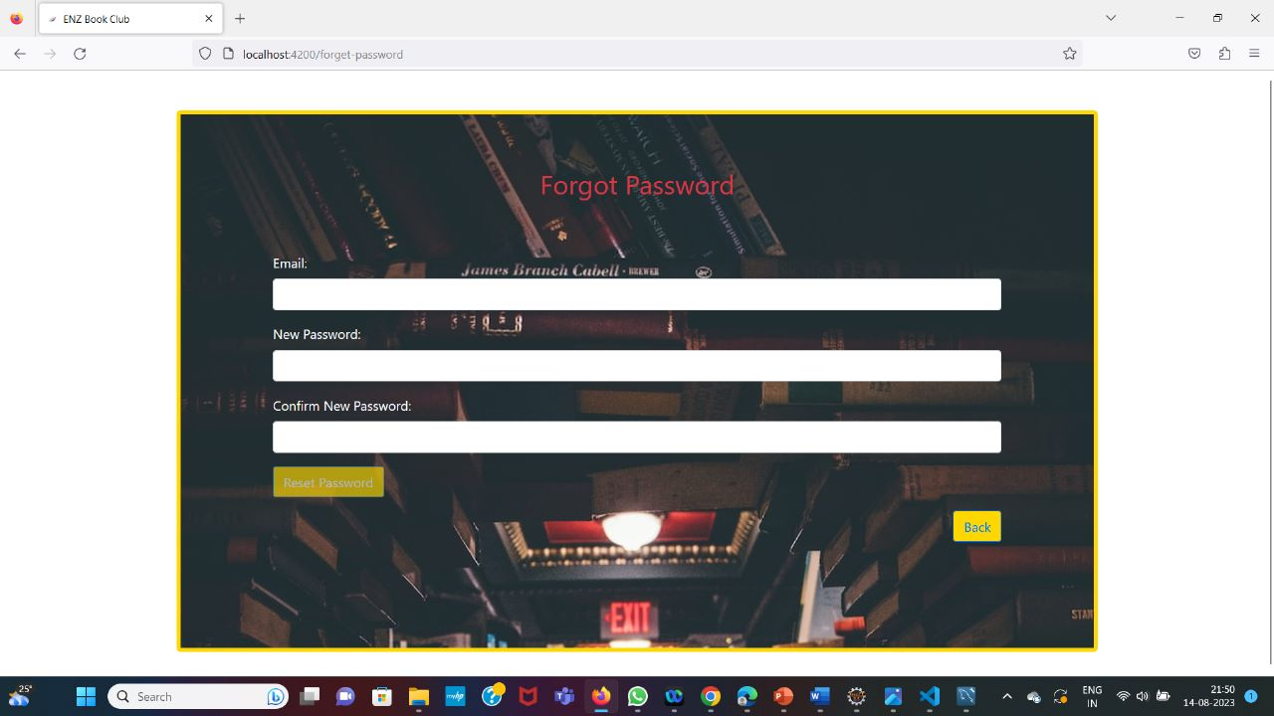
Forget Password

Slide 32
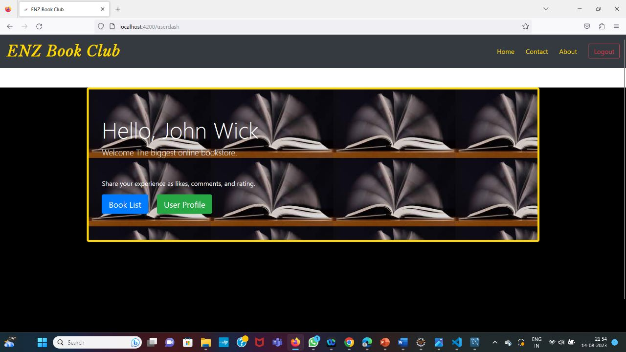
User DashBoard

Slide 33
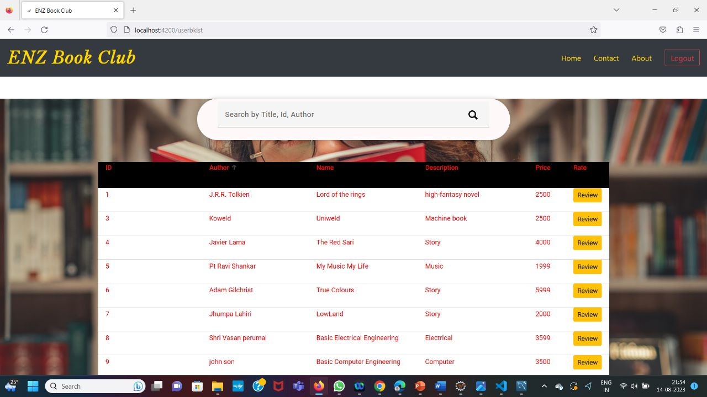
User BookList

Slide 34
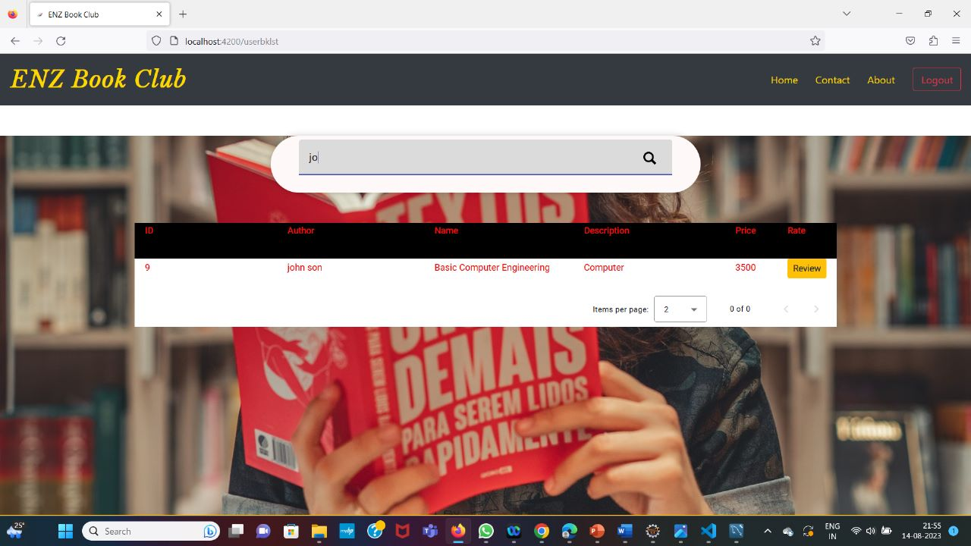
Searching for a Book

Slide 35
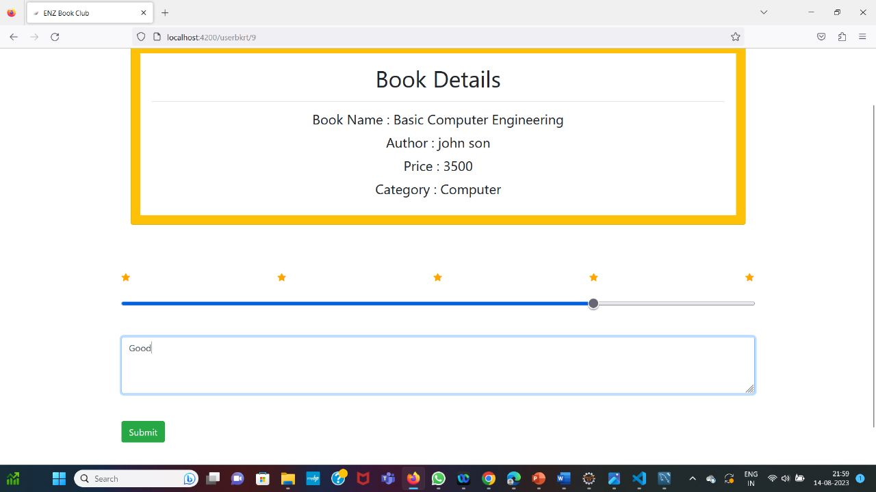
Rate a Book

Slide 36
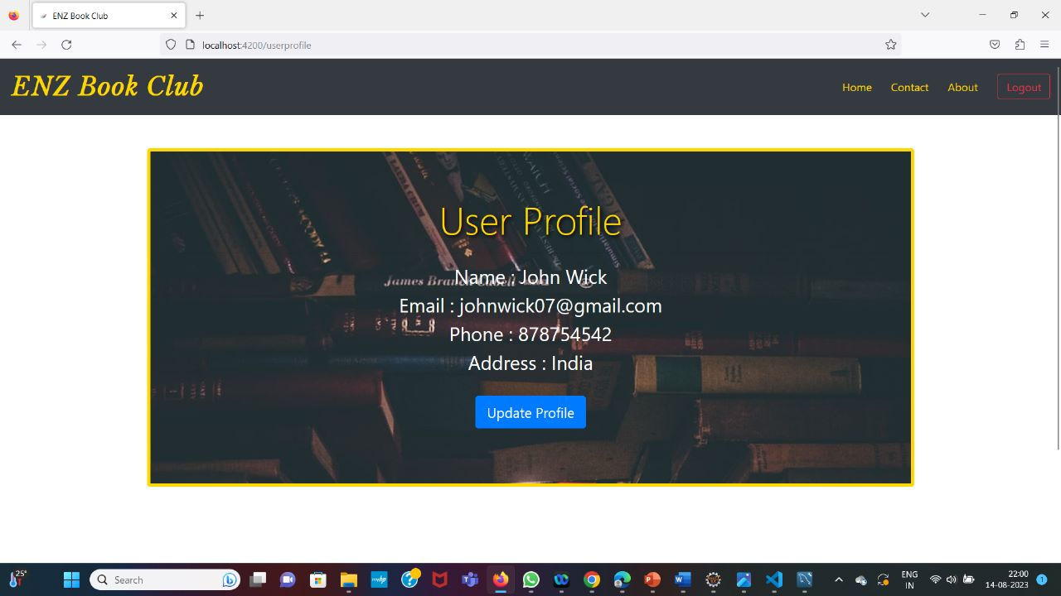
User Profile

Slide 37
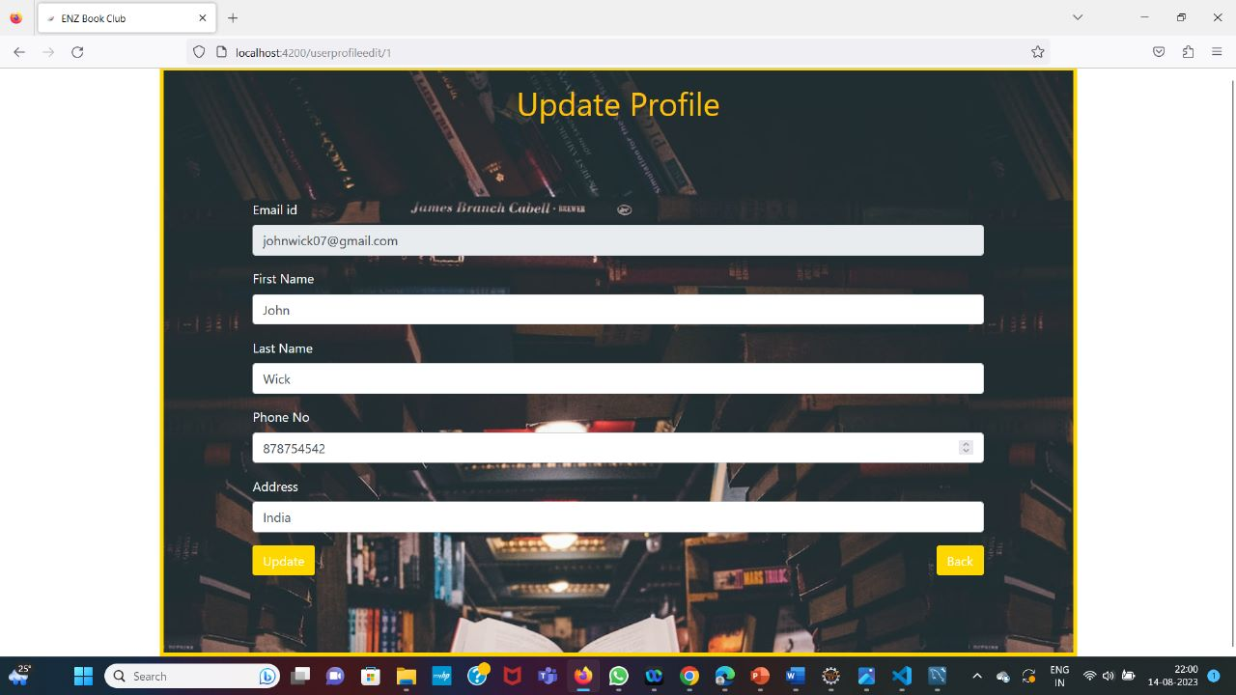
Update Profile

Slide 38
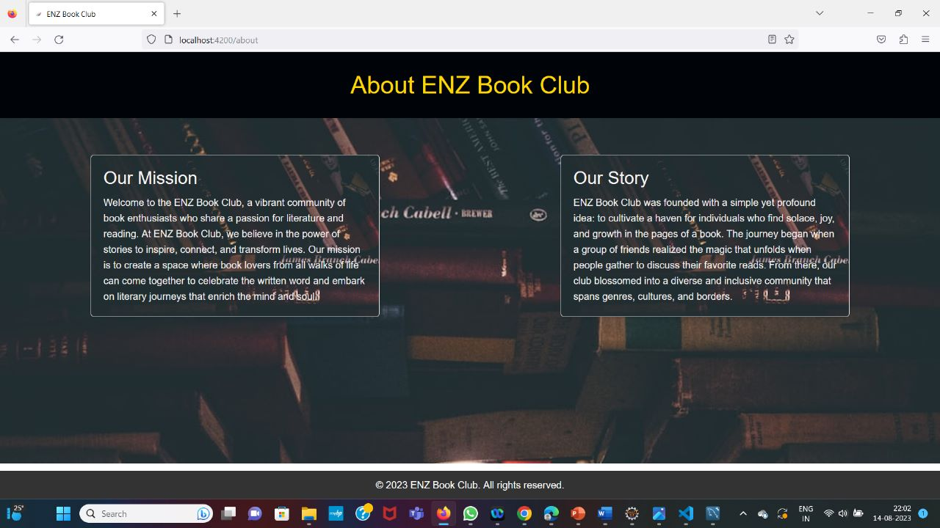
About ENZ Book Club

Slide 39
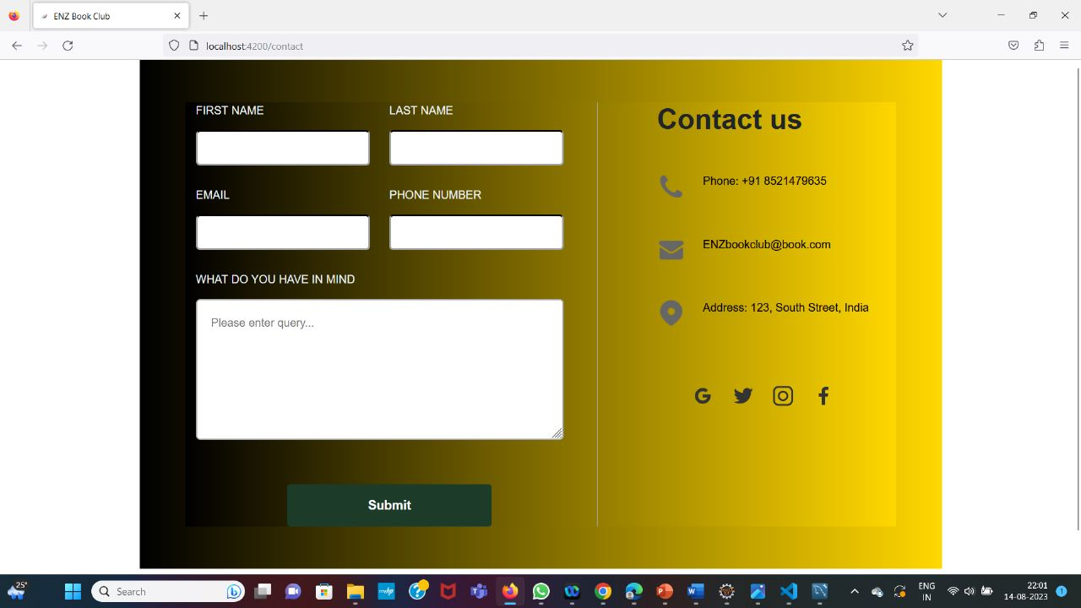
Contact Us

Slide 40
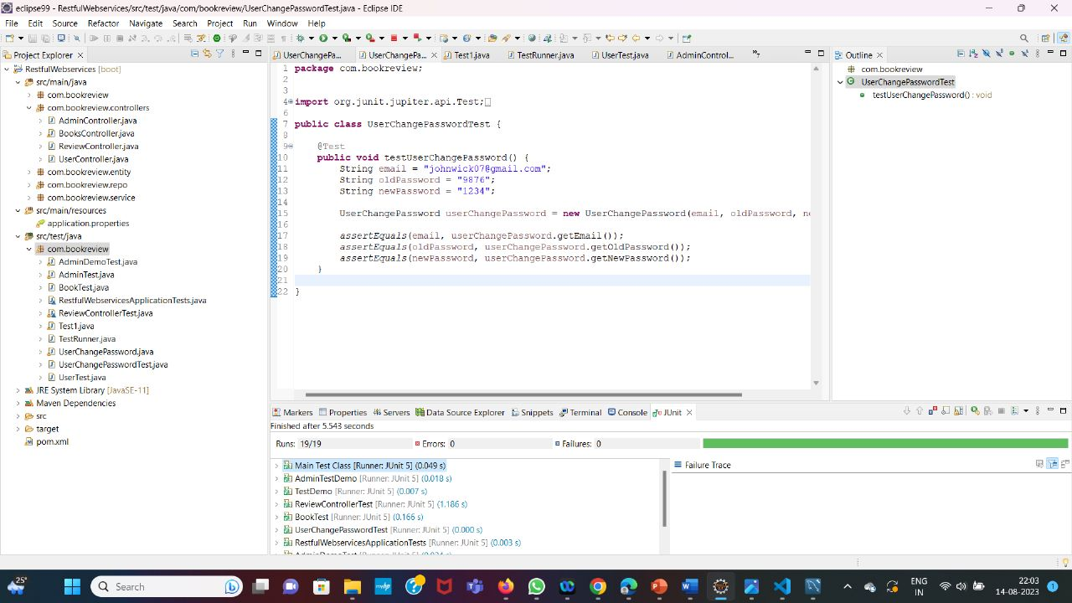
Junit Test Cases

Slide 41
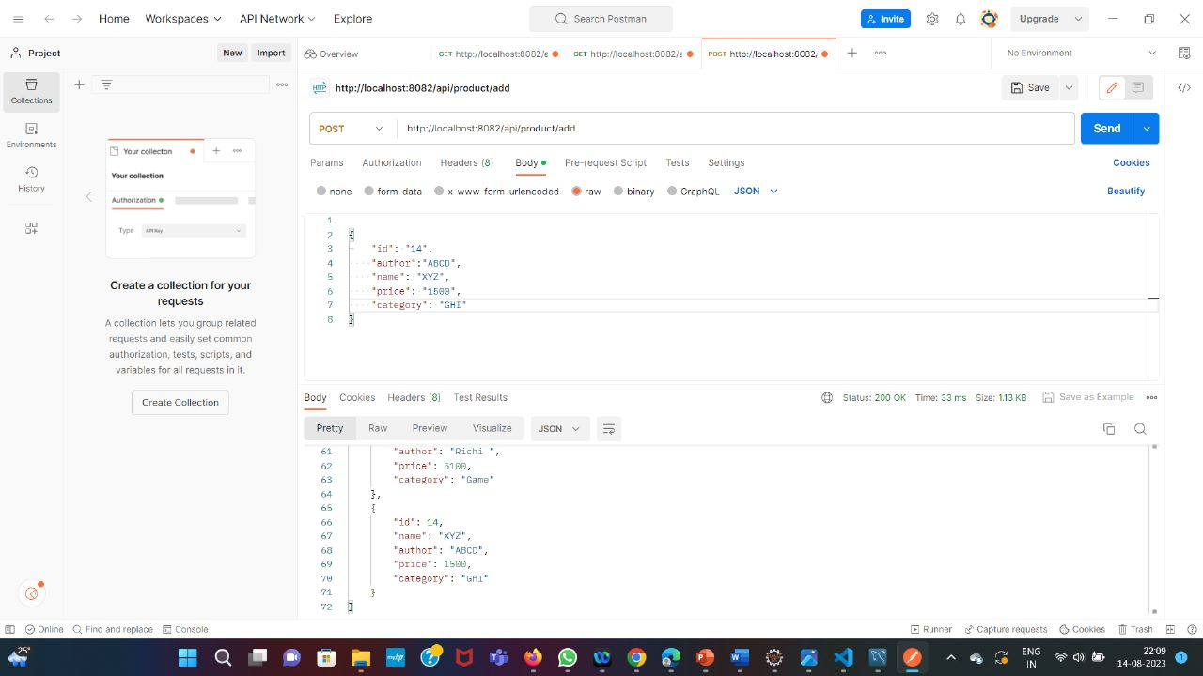
Postman: Post Method

Slide 42
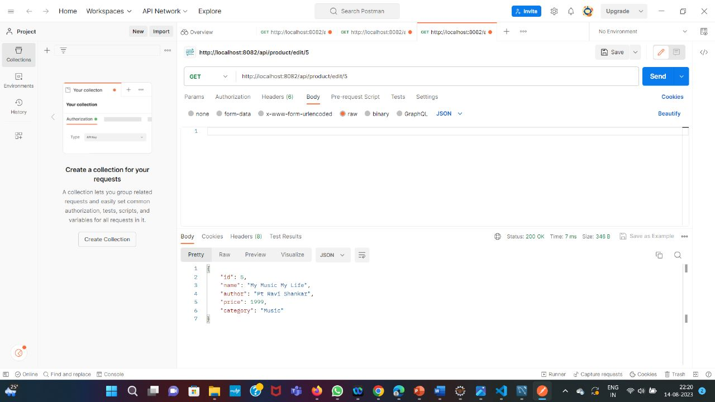
Get Method

Slide 43
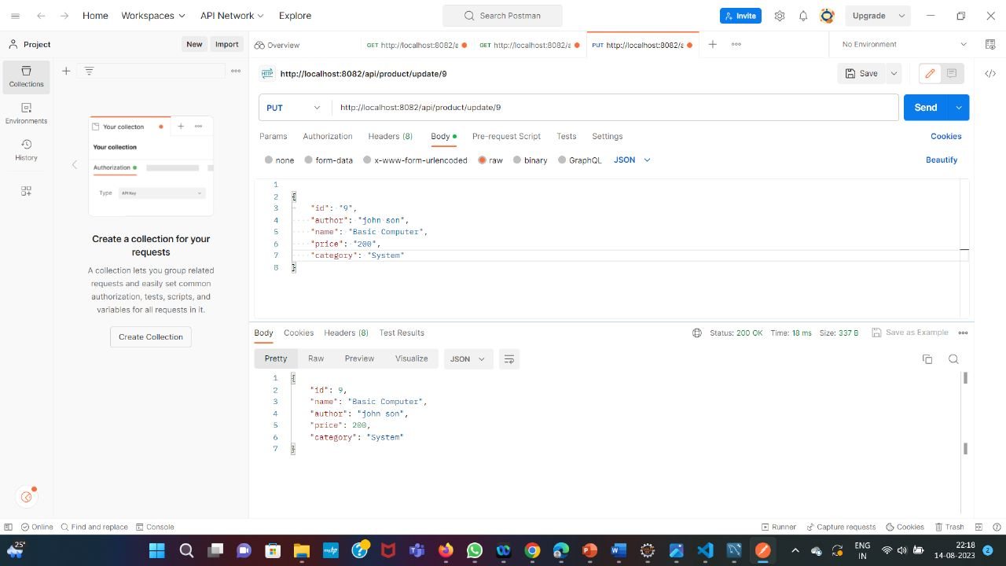
Put Method

Slide 44
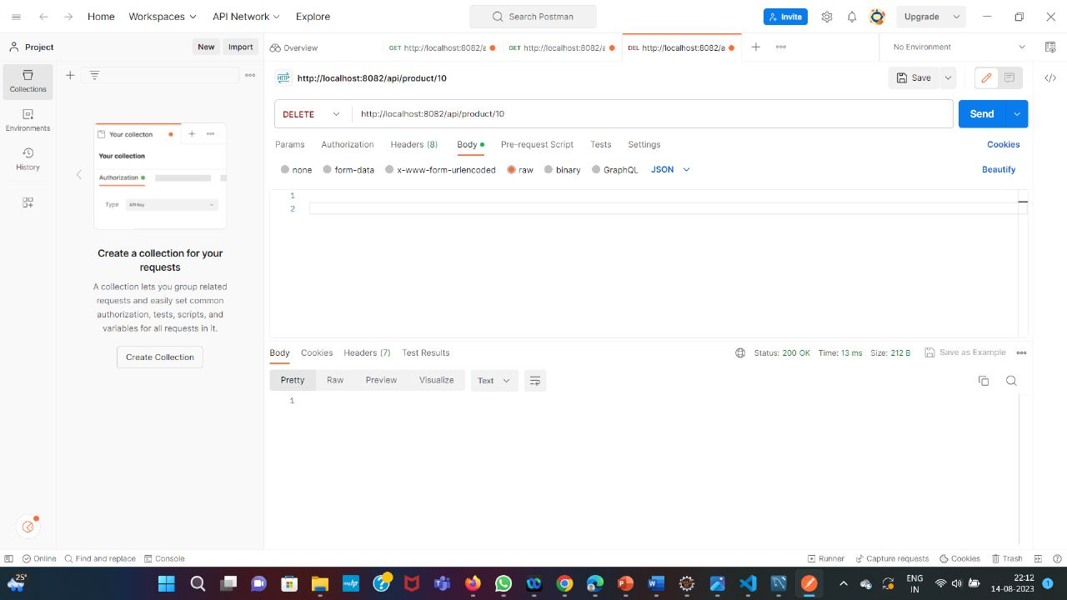
Delete Method

Slide 45
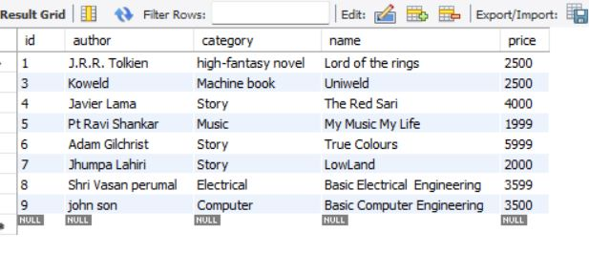
Showing the deleted book

Slide 46
Future Scope
We can improve our project by adding different library, and then filter books according to library.
Further we want to add a recommendation system which will suggest the books according to his previous searches.
We also want to integrate Google Maps API so that buyers can get the exact location of the seller.

Slide 47
Conclusion
A book review system gives a reader the better understanding of the books .
Allows the admin to better understand what it is the readers are looking for.
This gives books greater visibility and a greater chance of getting found by more readers
Helps the users to easily find the books of their interest
Save readers time, prepare them for what they will find and offer them a greater chance of connecting with a particular book, even before they read the first page

Slide 48


